Slide 1
CSE 3812: AI Lab
Week 1

Slide 2
PART I
The journey ahead of us!

Slide 3
What You Will Learn
Python basics
A* search
Hill climbing (example problem: sorting or 8-puzzle)
K-nearest neighbor (KNN)
Logistic Regression (LR)
K-means clustering (KMC)

Slide 4
The Marks Distribution
Attendance 10%
Offline 50% (best 4 out of 5)
marks will fully depend on your viva and understanding
Class Test – written quiz 10%
Mid 15% - written quiz
Final 15% - written quiz

Slide 5
AI and ML
Python basics
A* search
Hill climbing (example problem: sorting or 8-puzzle)
K-nearest neighbor (KNN)
Logistic Regression (LR)
K-means clustering (KMC)
AI based problems
AI and ML based problems

Slide 6
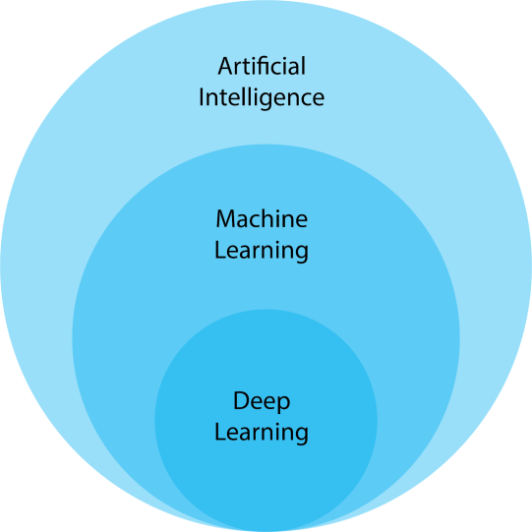
AI and ML

Slide 7
THE AI PART
Based on BFS
Based on Heuristics

Slide 8
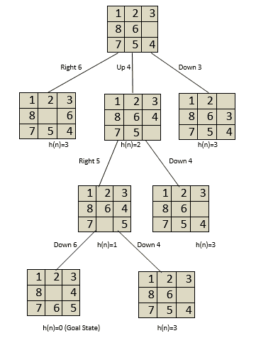
THE AI PART
Based on BFS
Based on Heuristics
Don’t worry if you do
not understand heuristics now!

Slide 9
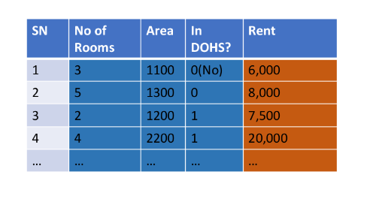
THE AI AND ML PART
What will be the price of a house if it has 4 rooms,
has an area of 1200 sq feet and is outside DOHS?

Slide 10

Machine Learning

Slide 11

Machine Learning
What will be the price of a house if it has 4 rooms,
has an area of 1200 sq feet and is outside DOHS?
7200.28

Slide 12
PART II
Python Basics and Application

Slide 13
Contents
Python Basics
Installation
Variables
Conditional Statements
Functions
Loops
Data Structures
List, Dictionary, Tuple, Set
Class and Objects
BFS using Python
DFS using Python
Graph Coloring using Python

Slide 14
Python Basics
Installation
Basically you will be downloading the python interpreter and some python libraries
Go to the following link and click on the Download Python button
A .exe file will be downloaded
Run the .exe file - the rest is straight forward

Slide 15
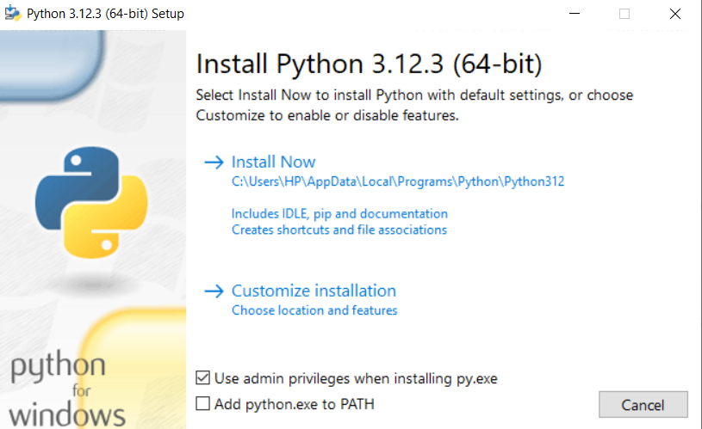
Python Basics
Installation
Basically you will be downloading the python interpreter and some python libraries
Go to the following link and click on the Download Python button
A .exe file will be downloaded
Run the .exe file - the rest is straight forward

Slide 16
Python Basics
Variables, If Else, Loops and Functions
Let us solve the following
Let us solve the following problem using Python
Write a python program to print a pattern
Write python program that finds the sum of the following series: 1+1.2+1.2.3+1.2.3.4+ …+1.2.3…(n-1).n
Write a python program that determines the nth term of the Fibonacci series

Slide 17
Contents
Python Basics
Installation
Variables
Conditional Statements
Functions
Loops
Data Structures
List, Dictionary, Tuple, Set
Class and Objects
BFS using Python
DFS using Python
Graph Coloring using Python

Slide 18
DATA STRUCTURES LIST, DICTIONARY, TUPLE, SET
Note : The variables you will be using are just references

Slide 19
Python Basics - List
Data Structures – List (CRUD)
Create
append(item): Adds an item to the end of the list.
insert(index, item): Inserts an item at a specified index
Read
Accessing Elements: You can access elements by their index, e.g., list[index]
Iterating: Use a for loop to read through the list, e.g., for item in list:

Slide 20
Python Basics - List
Data Structures – List (CRUD)
Update
Modifying Elements: Directly assign a new value to an index, e.g., list[index] = new_value
Delete
remove(item): Removes the first occurrence of a specified item
pop(index) : Removes and returns the item at the given index

Slide 21
Python Basics - Dictionary
Create
dict[key] = value — Adds a new key-value pair or updates an existing key.
Read
dict[key] — Retrieves the value associated with a given key.
Use a for loop
Update
dict[key] = new_value — Updates the value of an existing key.
Delete
pop(key, default) — Removes the specified key and returns the corresponding value; if the key is not found, it returns default

Slide 22
Python Basics - Tuple
Tuples are like lists but immutable – cannot be changed
Create
You can create a tuple by directly assigning values to it
my_tuple = (1, 2, 3)
Read
Accessing elements in a tuple works the same way as in a list, using indexing
print(my_tuple[0])
You can use a for loop

Slide 23
Python Basics - Tuple
Update – cannot be done
But we can create a new tuple with the tuple’s original values + updated* values
Delete – cannot be done
But we create a new tuple with tuple’s original values, omitting the deleted* values

Slide 24
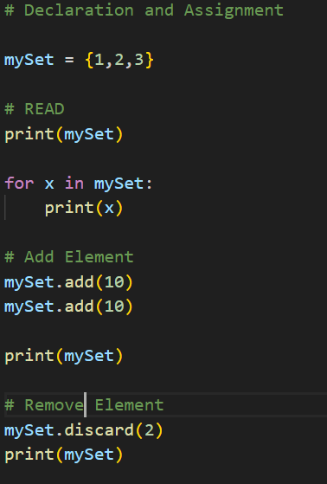
Python Basics - Set
What will be the output of this code?
At first try to predict yourself and write it down
Now write the code yourself
Core Operations of Set

Slide 25
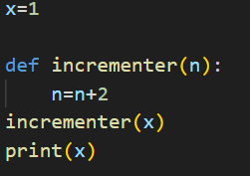
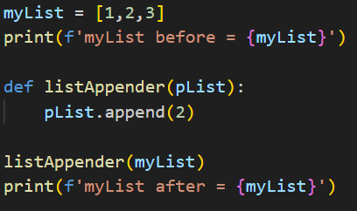
Pass By Value and Pass By Reference
What will be printed here?
What will be printed here?

Slide 26
Pass By Value and Pass By Reference
What will be printed here?
What will be printed here?
x – working as a primitive data type
myList – working as a reference to an object

Slide 27
Class and Object
Create a class called student
Create a constructor
Create a destructor
Create a function
Create two objects of the class student
Compare two objects
Will the objects be passed by value or passed by reference?

Slide 28
Contents
Python Basics
Installation
Variables
Conditional Statements
Functions
Loops
Data Structures
List, Dictionary, Tuple, Set
Class and Objects
BFS using Python
DFS using Python
Graph Coloring using Python

Slide 29
Some More Tasks Using Python
BFS using Python
DFS using Python
Graph Coloring using Python

Slide 30
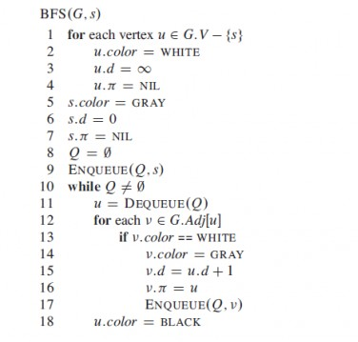
Some More Tasks Using Python
BFS using Python

Slide 31
Thank You

